Slide 1

RentBookRush - Online book rental Portal
GROUP 16
201801244 - Siddhi Patel
201801245 - Richa Patel
202012119 - Daya Yadav
Prof. JayPrakash Lalchandani

Slide 2
Project background
Purpose of project
In today’s time a lot of technologies are coming up like audiobooks, kindle, digital library etc., but some book readers still are connected with the traditional way of reading a book. Our tool ‘Online book rental system’ is made with an easy user interface. Vendors add books on the website and renters rent the book.

Slide 3
Tools and Technologies
Database: MySQL
Front-End: HTML, CSS, JavaScript
Back-End: PHP

Slide 4
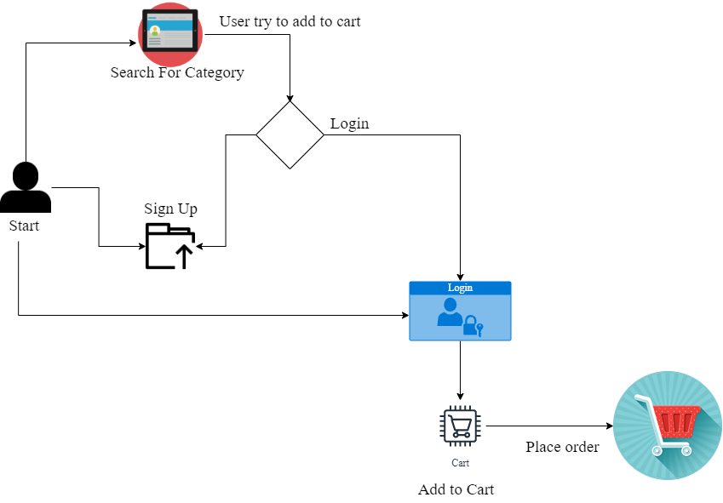
Critical path

Slide 5
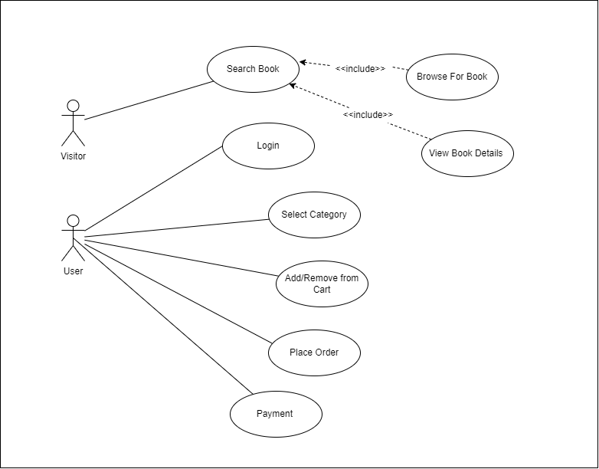
Use Case

Slide 6
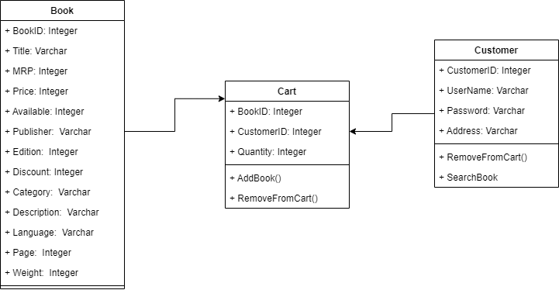
Class Diagram

Slide 7
Business rules for our system
Pricing administration by admin manually, and will be independent of demand supply
Fairness: First come first serve, no special service for any user.
Without login, one can’t search or rent book
Privacy: only admin can see any user’s rent history

Slide 8
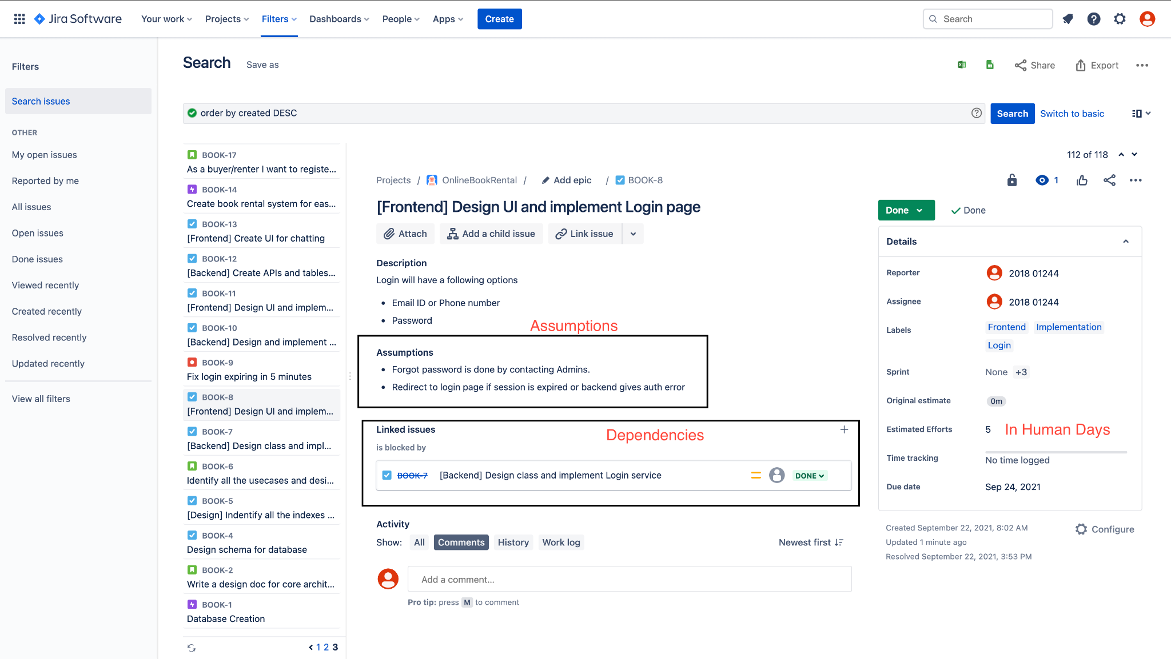
Assumption and dependencies

Slide 9
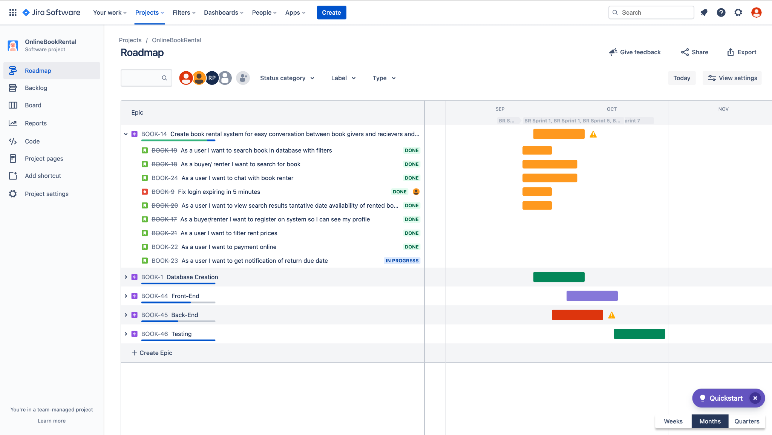
Gantt chart
Notes:
https://dayayadav.atlassian.net/jira/software/projects/BOOK/boards/1/roadmap

Slide 10
Design and implementation constraints
The most important constraint is security. They should not be communicated through unsafe mode. And passwords should be encrypted
Admin should control and alter everything
Implementation should be modular and extensible
Implementation should be unit tested and integration tested.

Slide 11
UI/UX design of the complete system

Slide 12
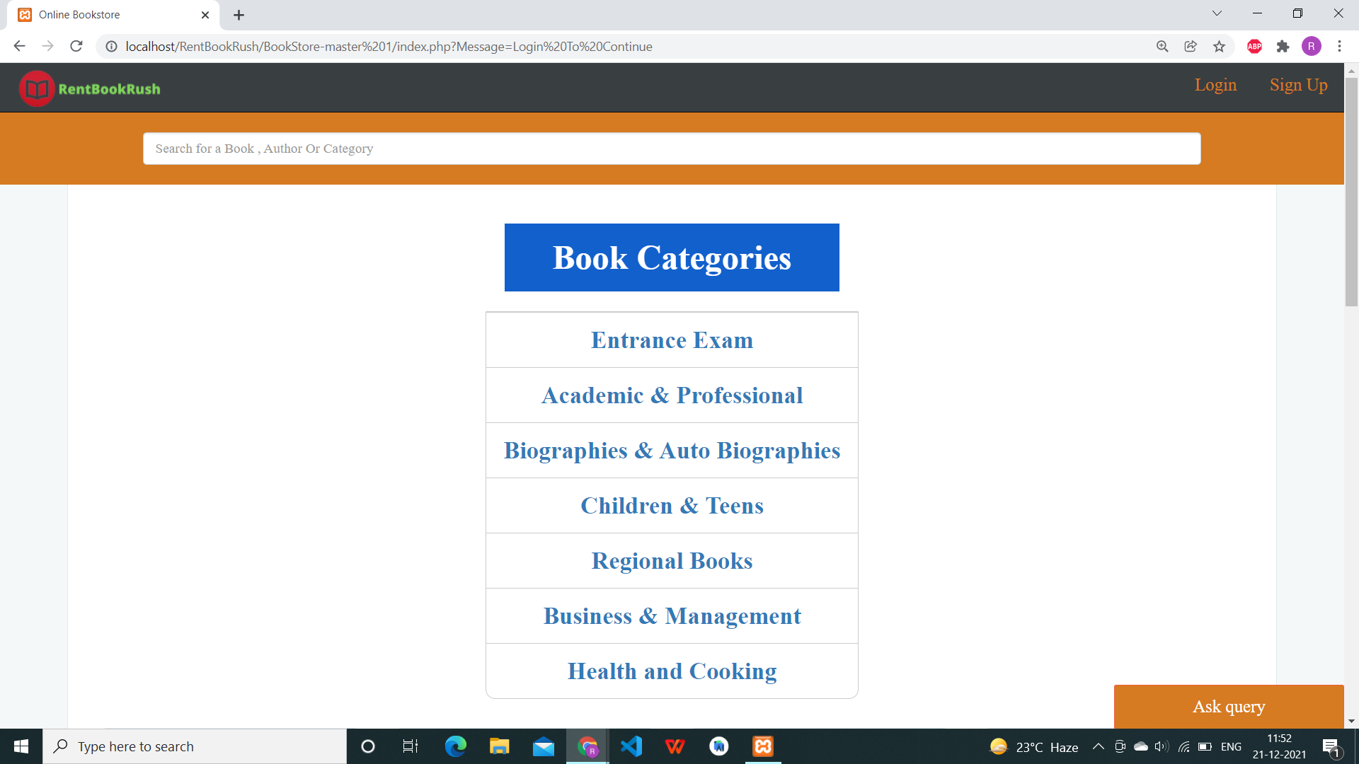
Home Page

Slide 13
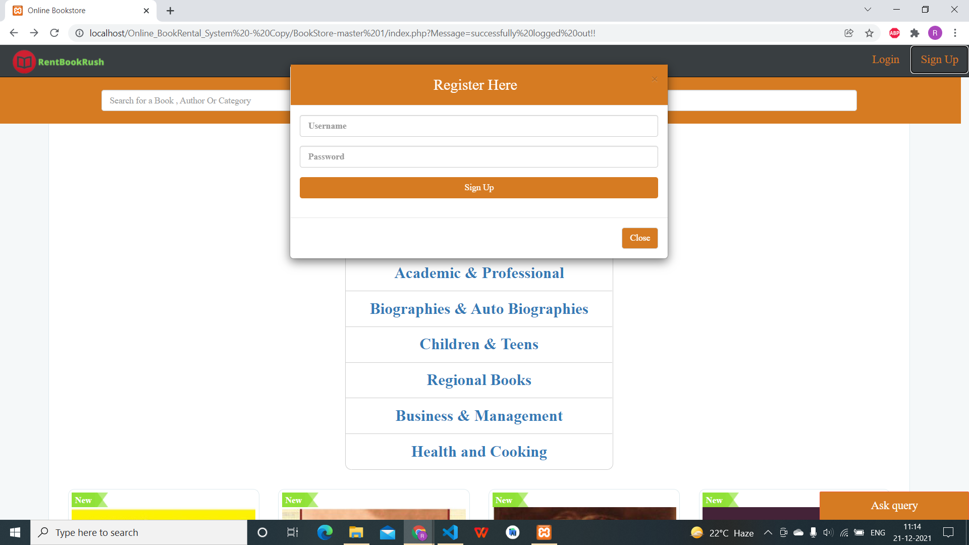
User : Registration

Slide 14

User : Login

Slide 15
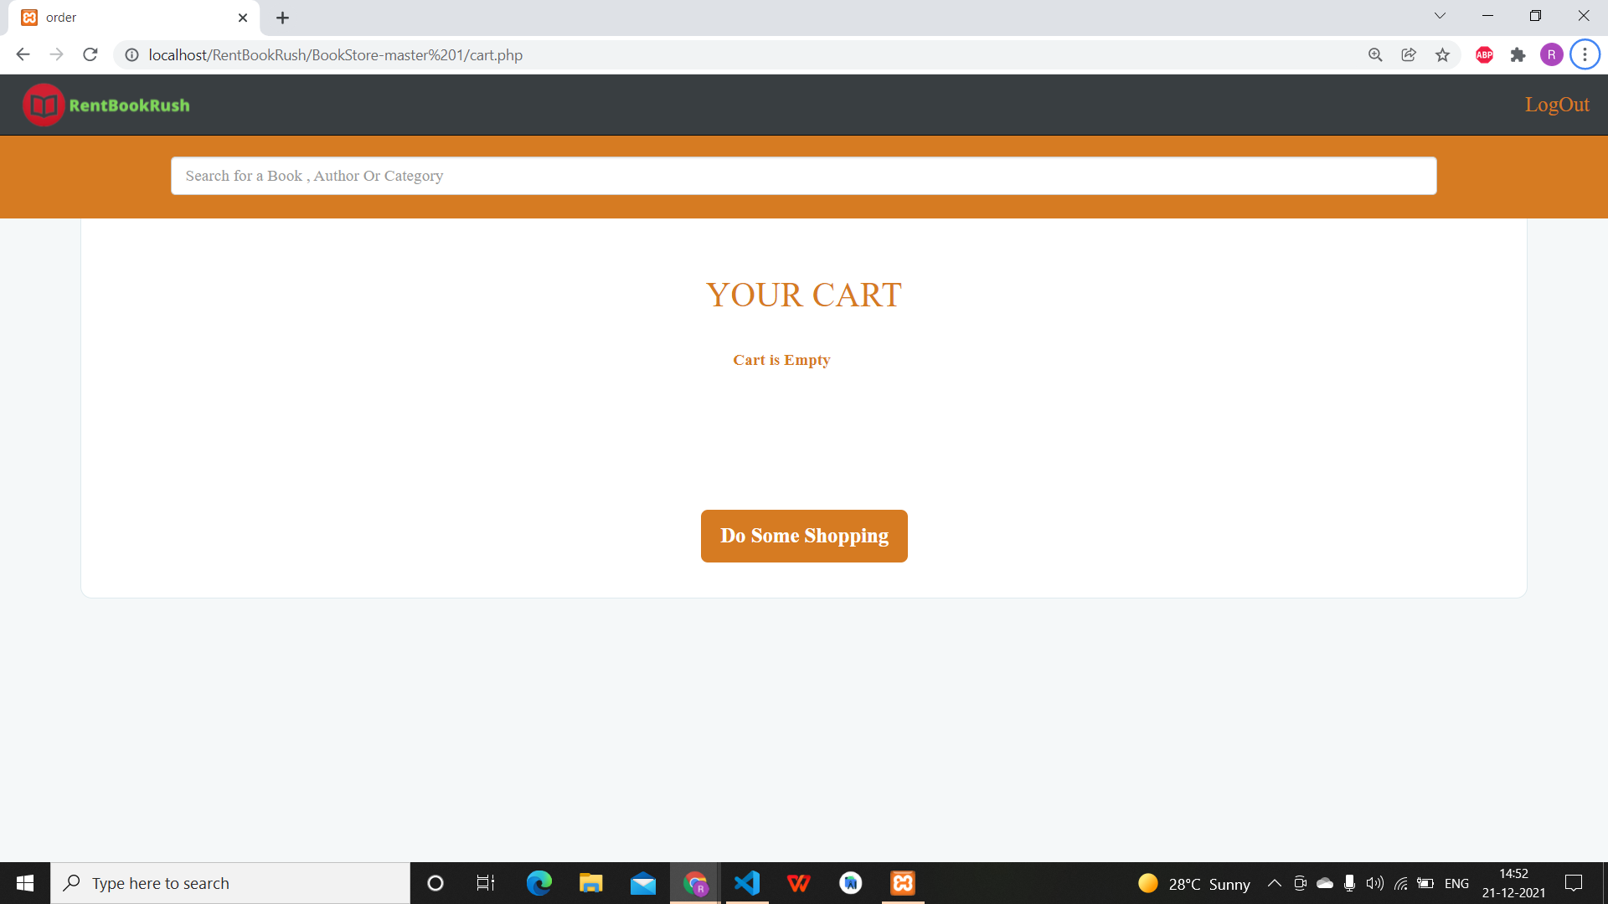
Empty Cart

Slide 16
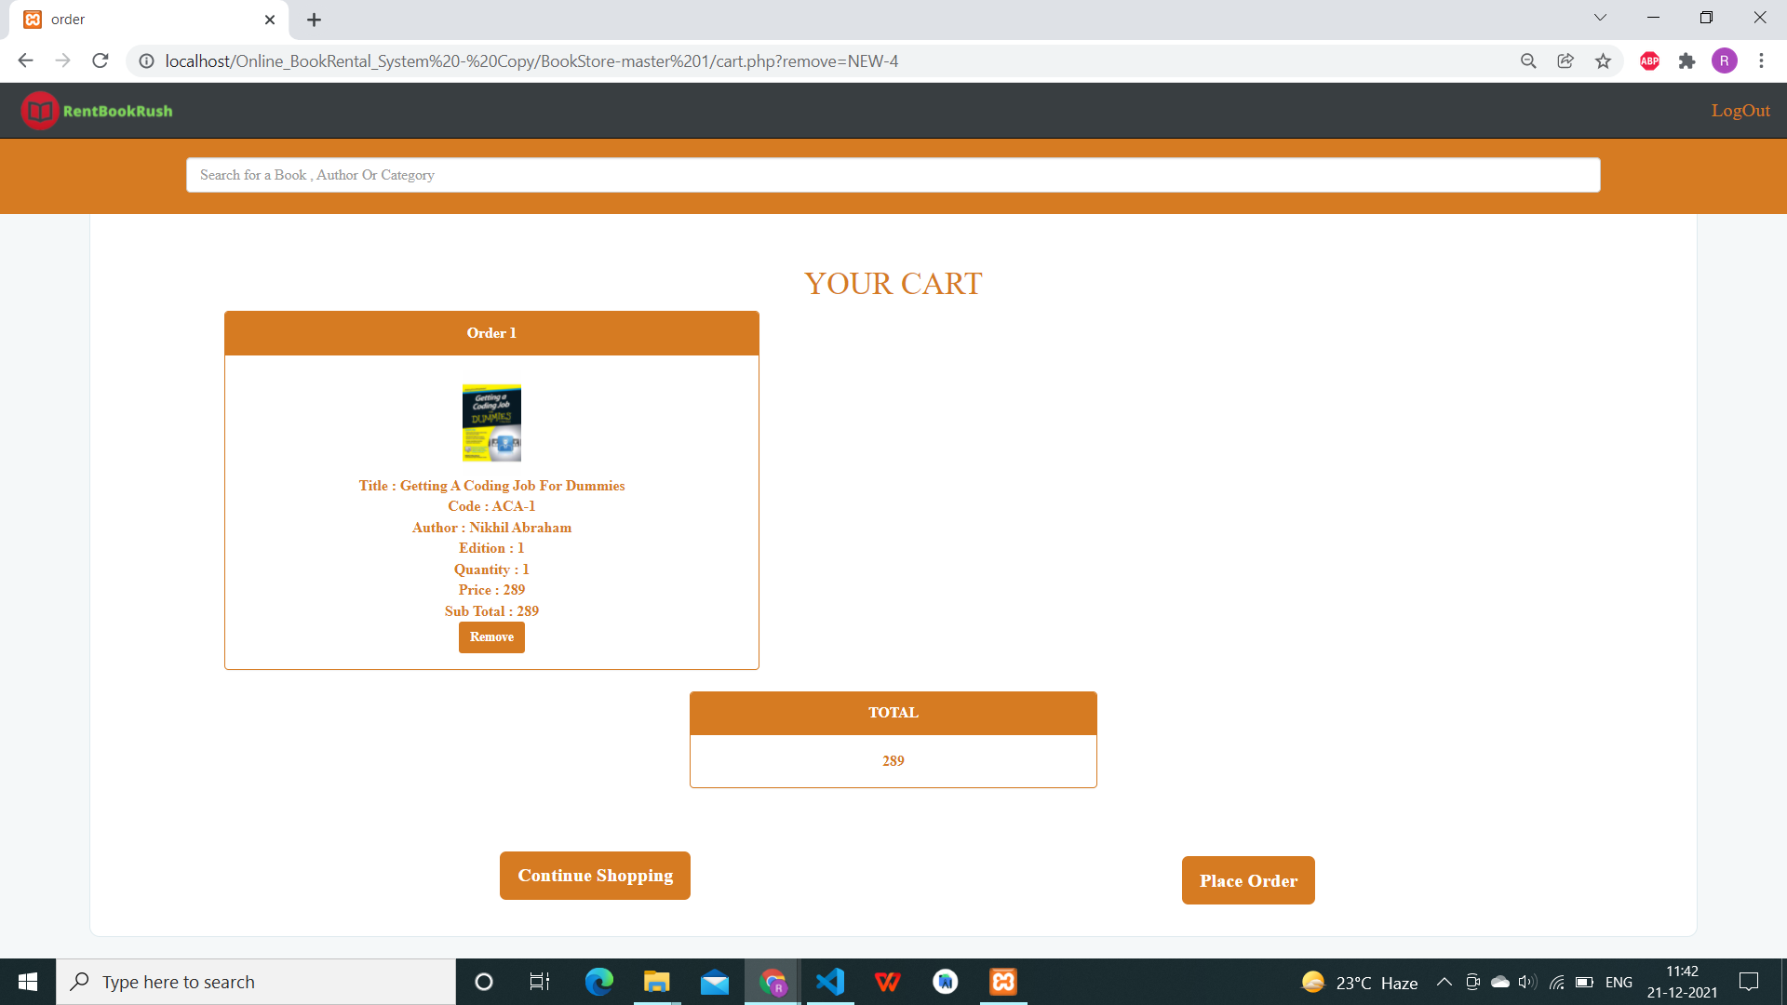
Case 1 : 1 book in cart

Slide 17
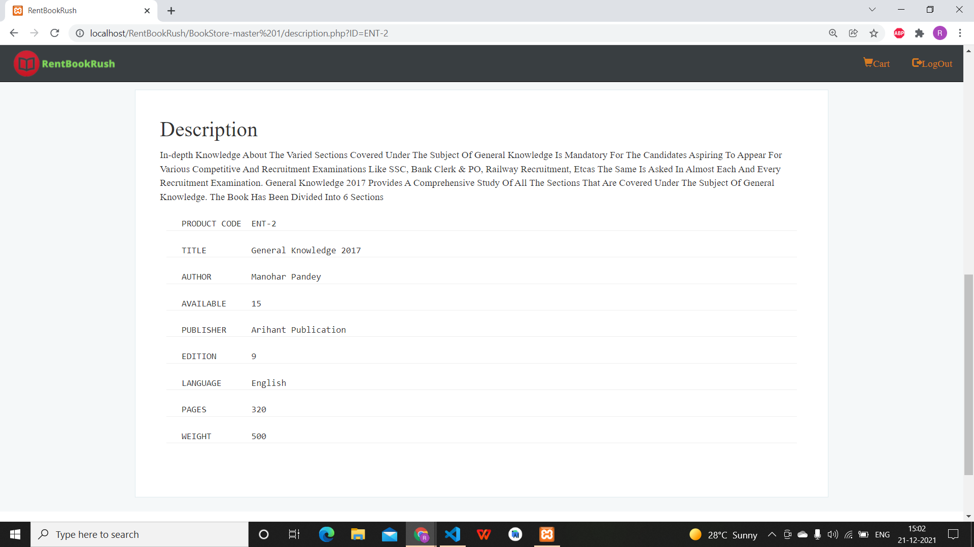
Book Description

Slide 18
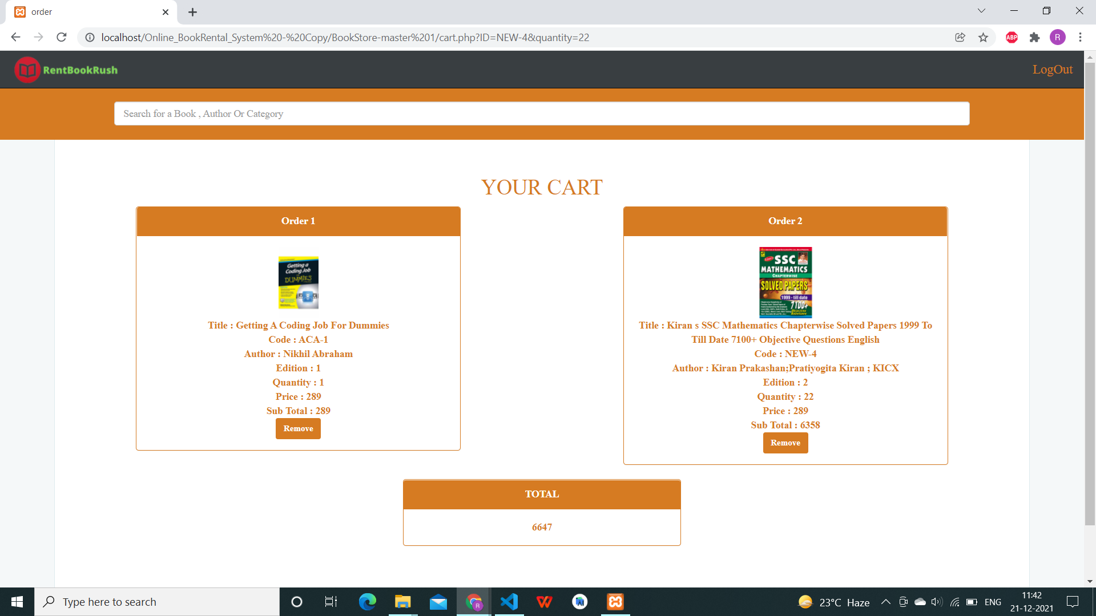
CASE 2 : Order of 23 books

Slide 19
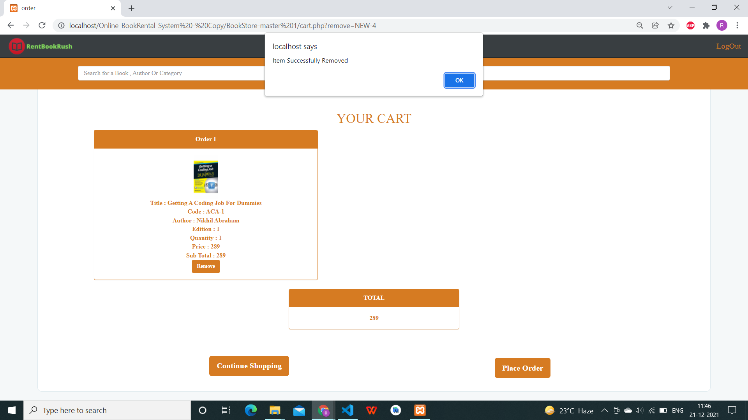
Book Removed from cart

Slide 20
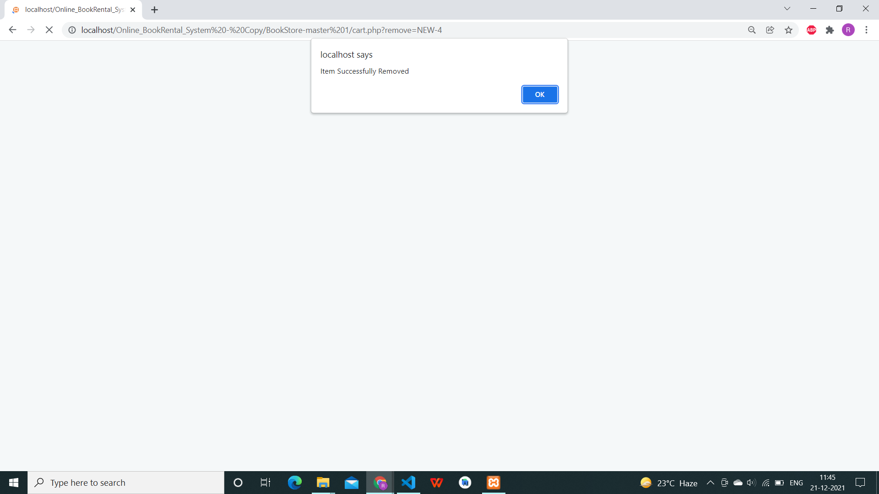
Status Token : Book Removed from cart

Slide 21
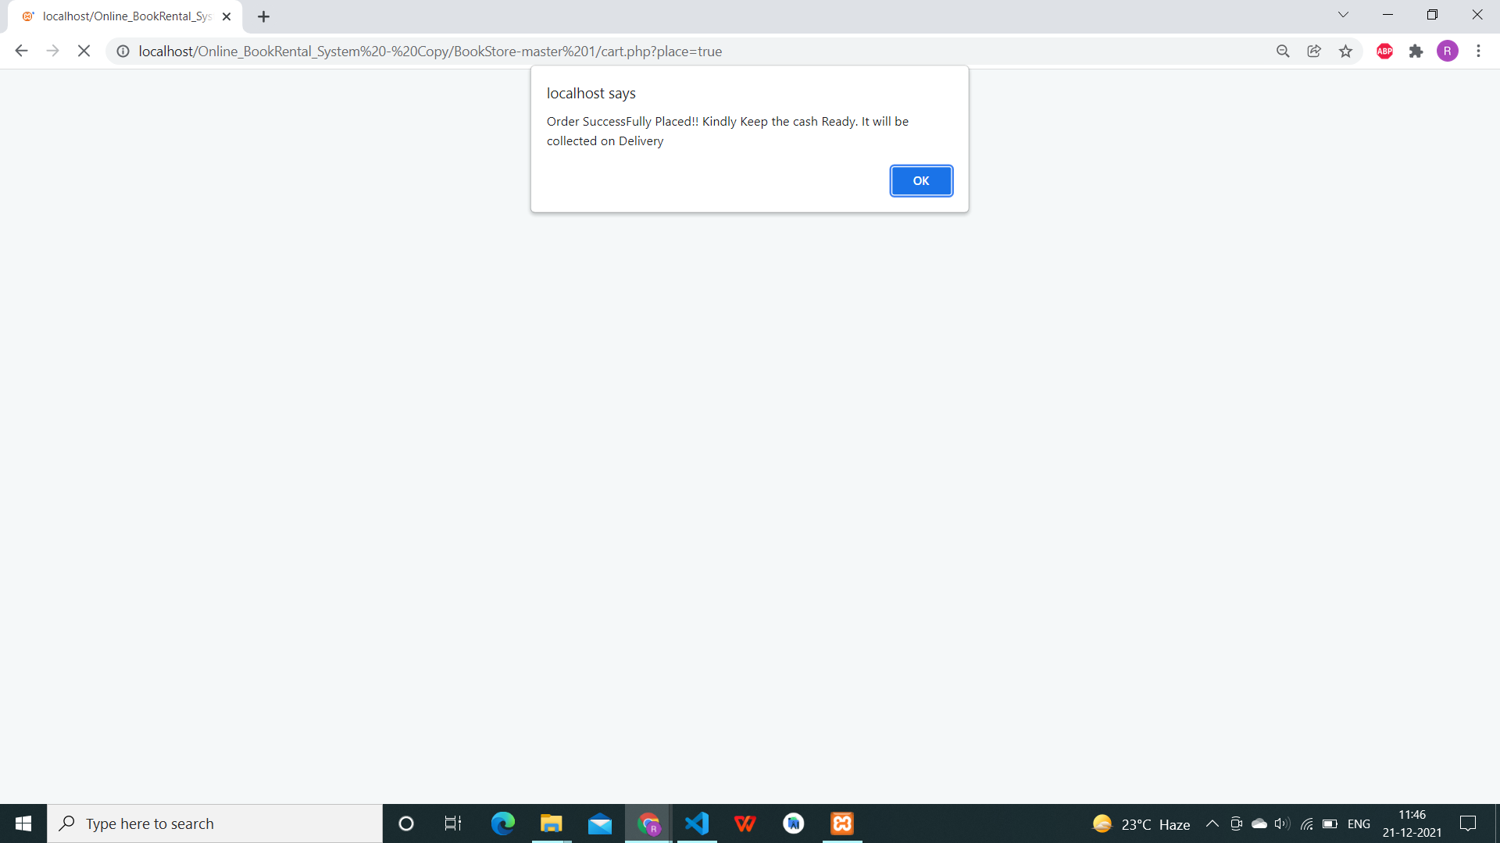
status token : Order placed

Slide 22
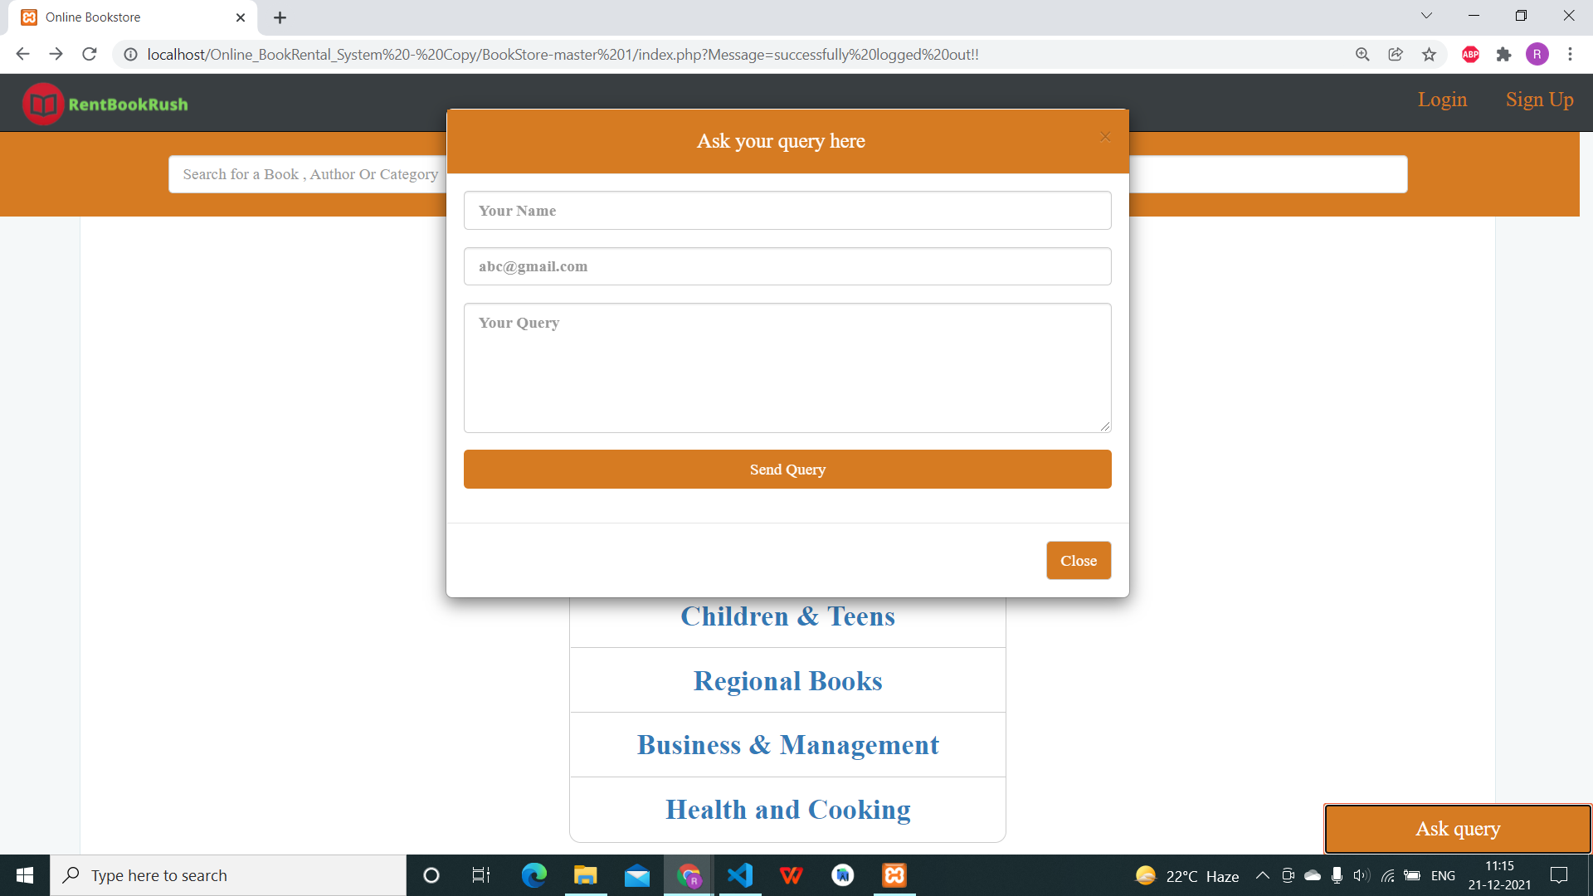
Ask Query:

Slide 23

Logout

Slide 24
Team members contribution
Student ID | Name | Work Domain
201801244 | Siddhi Patel | Database Administration, Backend Development, Jira assumption, dependencies, gantt chart, business rules
201801245 | Richa Patel | Frontend Development,User Experience, Testing, Ui designing
202012119 | Daya Yadav | Database Administration, Frontend Development, class diagram, use case, architecture model

Slide 25
Thank you
Thank you

